Slide 1
Overview of Distributed Systems

Slide 2
Learning Objectives
Define a distributed system and explain its importance for companies and for individuals.
Describe the goals of distributed systems and how they relate to the internet architecture.
Define different types of distributed systems and their taxonomy.
Notes:
Students may not know exactly what is meant by globalization or may have an incomplete understanding of the term. You might ask students what they think it means. Potential answers could include: reduction of economic and cultural advantages of developed countries, increased number of companies with operations in multiple countries worldwide, and increased reliance on imports and exports of goods (and jobs). Globalization will be discussed in later slides as well.

Slide 3
What is a Distributed System?
A collection of independent computers that appears to its users as a single coherent system.
Features:
  No shared memory – message-based communication
  Each runs its own local OS
  Heterogeneity.
Ideal: to present a single-system image:
  The distributed system “looks like” a single computer rather than a collection of separate computers.

Slide 4
Distributed System Characteristics
To present a single-system image:
  Hide internal organization, communication details
  Provide uniform interface
Easily expandable
  Adding new computers is hidden from users
Continuous availability
  Failures in one component can be covered by other components
Supported by middleware

Slide 5
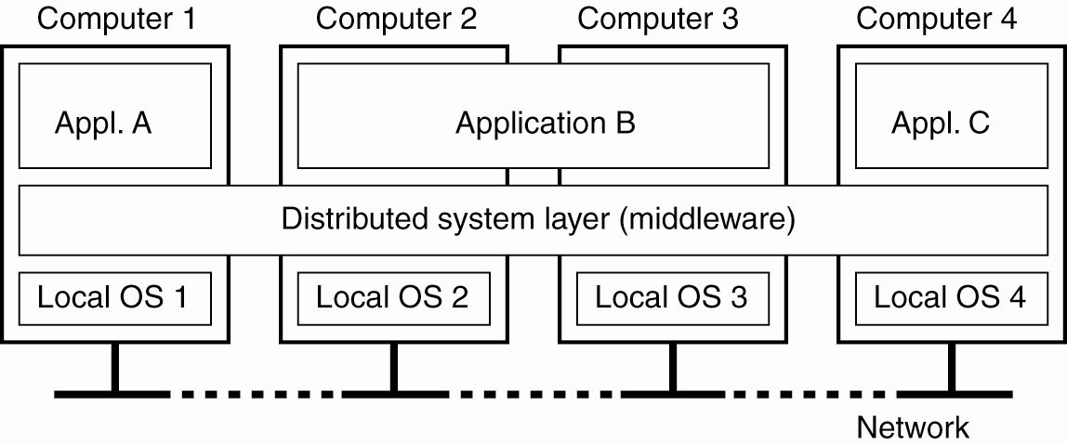
Definition of a Distributed System
Figure 1-1: A distributed system organized as middleware. The middleware layer runs on all machines, and offers a uniform interface to the system

Slide 6
Distributed Systems
Early distributed systems emphasized the single system image – often tried to make a networked set of computers look like an ordinary general purpose computer.
Examples: Amoeba, Sprite, NOW, Condor (distributed batch system), …
Distributed systems run distributed applications, from file sharing to large scale projects like SETI@Home http://setiathome.ssl.berkeley.edu/

Slide 7
Types of Distributed Systems
Distributed Computing Systems
  Clusters
  Grids
  Clouds
Distributed Information Systems
  Transaction Processing Systems
  Enterprise Application Integration
Distributed Pervasive Systems
  Home systems
  Health care systems
  Sensor networks

Slide 8
1) Cluster Computing
A collection of similar processors (PCs, workstations) running the same operating system, connected by a high-speed LAN.
Parallel computing capabilities using inexpensive PC hardware.
Replace big parallel computers (Massively Parallel Processing systems – MPPs).

Slide 9
Clusters…
Historical Perspective - MPPs
Compare clusters to the Massively Parallel Processors of the 1990’s
Many separate nodes, each with its own private memory –hundreds or thousands of nodes (e.g., Cray T3E, nCube)
  Manufactured as a single computer with a proprietary OS, very fast communication network.
  Designed to run large, compute-intensive parallel applications
  Expensive, long time-to-market cycle.

Slide 10
Clusters…Cluster Types & Uses
High Performance Clusters (HPC)
  run large parallel programs
  Scientific, military, engineering apps; e.g., weather modeling
Load Balancing Clusters
  Front end processor distributes incoming requests
  server farms (e.g., at banks or popular web site)
High Availability Clusters (HA)
  Provide redundancy – back up systems
  May be more fault tolerant than large mainframes

Slide 11
Clusters...Beowolf model
Linux-based
Master-slave paradigm
  One processor is the master; allocates tasks to other processors, maintains batch queue of submitted jobs, handles interface to users
  Master has libraries to handle message-based communication or other features (the middleware).

Slide 12
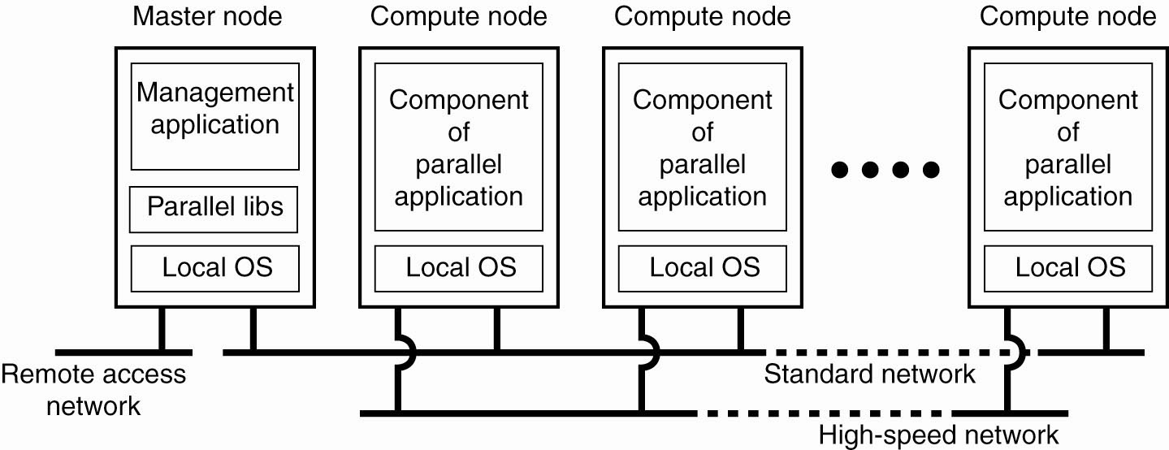
Clusters… A Beowolf Cluster Computing System
Figure 1-6. An example of a (Beowolf) cluster computing system

Slide 13
Clusters…
MOSIX model
Provides a symmetric, rather than hierarchical paradigm
  High degree of distribution transparency (single system image)
  Processes can migrate between nodes dynamically and preemptively (more about this later.) Migration is automatic
Used to manage Linux clusters.

Slide 14
Clusters… More About MOSIX
“Operating-system-like”; looks & feels like a single computer with multiple processors
Supports interactive and batch processes
Provides resource discovery and workload distribution among clusters
Clusters can be partitioned for use by an individual or a group
Best for compute-intensive jobs
“The MOSIX Management System for Linux Clusters, Multi-clusters, GPU Clusters and Clouds”, A. Barak and A. Shiloh”_x000b_

Slide 15
2) Grid Computing Systems
Modeled loosely on the electrical grid.
Highly heterogeneous with respect to hardware, software, networks, security policies, etc.
Grids support virtual organizations: a collaboration of users who pool resources (servers, storage, databases) and share them.
Grid software is concerned with managing sharing across administrative domains.

Slide 16
Grids…Features
Similar to clusters but processors are more loosely coupled, tend to be heterogeneous, and are not all in a central location.
Can handle workloads similar to those on supercomputers, but grid computers connect over a network (Internet?) and supercomputers’ CPUs connect to a high-speed internal bus/network
Problems are broken up into parts and distributed across multiple computers in the grid – less communication between parts than in clusters.

Slide 17
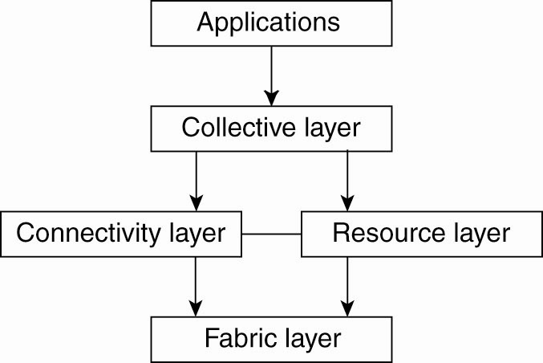
Grids… Generic Architecture for Grid Systems
Fabric Layer: interfaces to local resources at a specific site.
Connectivity Layer: protocols to support usage of multiple resources for a single application; e.g., access a remote resource or transfer data between resources; and protocols to provide security.
Resource Layer manages a single resource, using functions supplied by the connectivity layer.
Collective Layer: resource discovery, allocation, scheduling, etc.
Applications: use the grid resources.
The collective, connectivity and resource layers together form the middleware layer for a grid.
Figure 1-7: A layered architecture for grid computing systems

Slide 18
Grids… OGSA – A Grid Architecture
Open Grid Services Architecture (OGSA) is a service-oriented architecture.
  Sites that offer resources to share do so by offering specific Web services.
The architecture of the OGSA model is more complex than the previous layered model.

Slide 19
Grids… A Grid Architecture – Globus Toolkit
An example of grid middleware
Supports the combination of heterogeneous platforms into virtual organizations.
Implements the OSGA standards, among others.

Slide 20
Grids… Other Grid Resources
The Globus Alliance: “a community of organizations and individuals developing fundamental technologies behind the "Grid," which lets people share computing power, databases, instruments, and other on-line tools securely across corporate, institutional, and geographic boundaries without sacrificing local autonomy”.
Grid Computing Info Center: “aims to promote the development and advancement of technologies that provide seamless and scalable access to wide-area distributed resources”.

Slide 21
3) Cloud Computing
Provides scalable services as a utility over the Internet.
Often built on a computer grid
Users buy services from the cloud.
  Grid users may develop and run their own software
Cluster/grid/cloud distinctions blur at the edges!

Slide 22
Types of Distributed Systems
Distributed Computing Systems
  Clusters
  Grids
  Clouds
Distributed Information Systems
Distributed Pervasive Systems

Slide 23
Distributed Information Systems
Business-oriented
Systems to make a number of separate network applications interoperable and build “enterprise-wide information systems”.
Two types discussed here:
  Transaction processing systems
  Enterprise application integration (EAI)

Slide 24
Distributed Info. Systems… a) Transaction Processing Systems
Provide a highly structured client-server approach for database applications
Transactions are the communication model
Obey the ACID properties:
  Atomic: all or nothing
  Consistent: invariants are preserved
  Isolated (serializable)
  Durable: committed operations can’t be undone

Slide 25
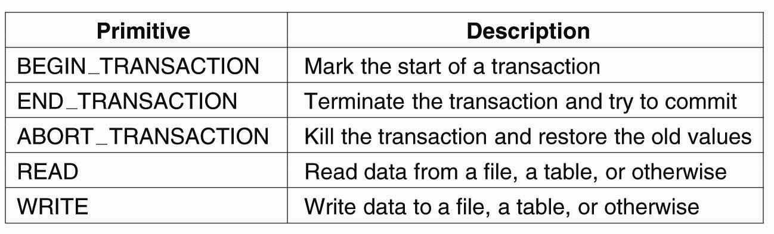
Distributed Info. Systems… Transaction Processing Systems
Figure 1-8: Example primitives for transactions

Slide 26
Distributed Info. Systems… Transactions
Transaction processing may be centralized (traditional client/server system) or distributed.
A distributed database is one in which the data storage is distributed – connected to separate processors.

Slide 27
Distributed Info. Systems… Nested Transactions
A nested transaction is a transaction within another transaction (a sub-transaction)
  Example: a transaction may ask for two things (e.g., airline reservation info + hotel info) which would spawn two transactions that get nested.
Primary transaction waits for the results.
  While children are active parent may only abort, commit, or spawn other children

Slide 28
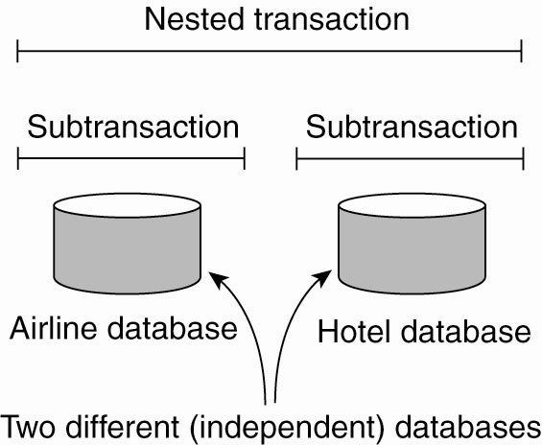
Distributed Info. Systems… Transaction Processing Systems
Figure 1-9: A nested transaction.

Slide 29
Distributed Info. Systems… Implementing Transactions
Conceptually, private copy of all data
Actually, usually based on logs
Multiple sub-transactions – commit, abort
  Durability is a characteristic of top-level transactions only.
Nested transactions are suitable for distributed systems.
  Transaction processing monitor may interface between client and multiple data bases.

Slide 30
Distributed Info. Systems… b) Enterprise Application Integration
Less structured than transaction-based systems
EA components communicate directly
  Enterprise applications are things like HR data, inventory programs, …
  May use different OSs, different DBs but need to interoperate sometimes.
Communication mechanisms to support this include CORBA, Remote Procedure Call (RPC) and Remote Method Invocation (RMI)

Slide 31
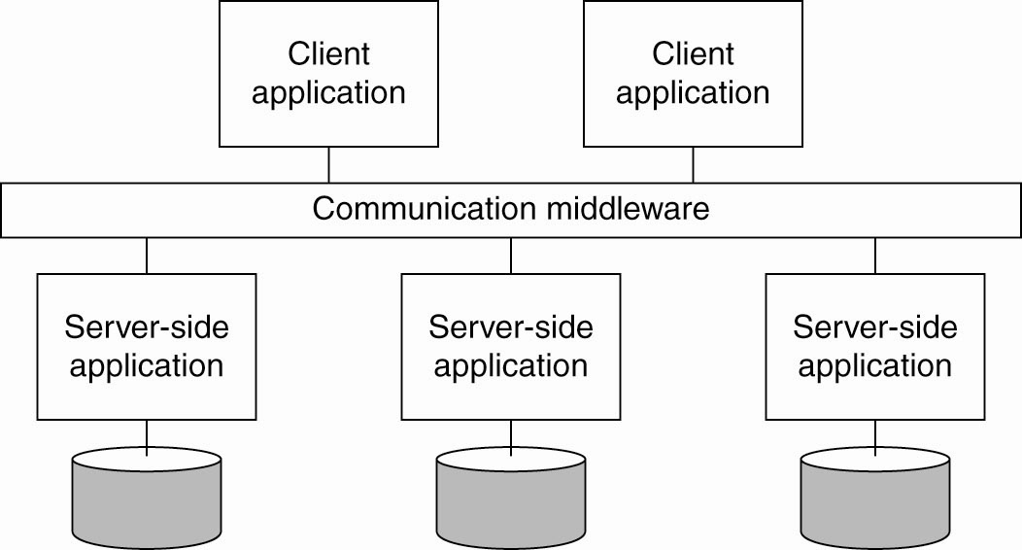
Distributed Info. Systems… Enterprise Application Integration
Figure 1-11. Middleware as a communication facilitator in enterprise application integration.

Slide 32
Types of Distributed Systems
Distributed Computing Systems
  Clusters
  Grids
  Clouds
Distributed Information Systems
Distributed Pervasive Systems

Slide 33
Distributed Pervasive Systems
The first two types of systems are characterized by their stability: nodes and network connections are more or less fixed.
This type of system is likely to incorporate small, battery-powered, mobile devices
  Home systems
  Electronic health care systems – patient monitoring
  Sensor networks – data collection, surveillance

Slide 34
Distributed Info. Systems… a) Home System
Built around one or more PCs, but can also include other electronic devices:
  Automated control of lighting, sprinkler systems, alarm systems, etc.
  Network enabled appliances.
  PDAs and smart phones, etc.

Slide 35
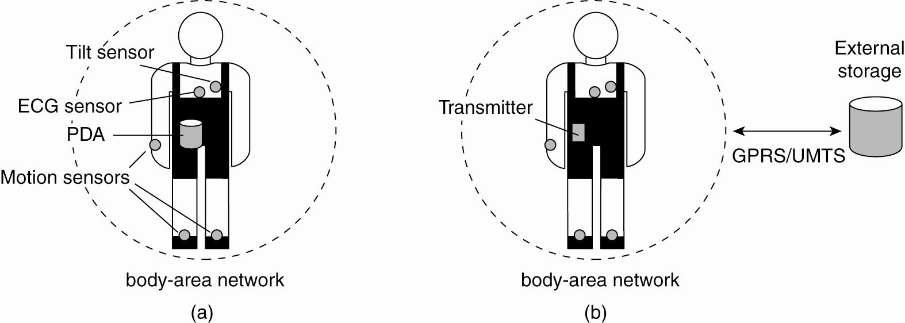
Distributed Info. Systems… b) Electronic Health Care Systems
Figure 1-12: Monitoring a person in a pervasive electronic health care system, using (a) a local hub or (b) a continuous wireless connection.

Slide 36
Distributed Info. Systems… c) Sensor Networks
A collection of geographically distributed nodes consisting of a comm. device, a power source, some kind of sensor, a small processor…
Purpose: to collectively monitor sensory data (temperature, sound, moisture etc.,) and transmit the data to a base station.
“smart environment” – the nodes may do some rudimentary processing of the data in addition to their communication responsibilities.

Slide 37
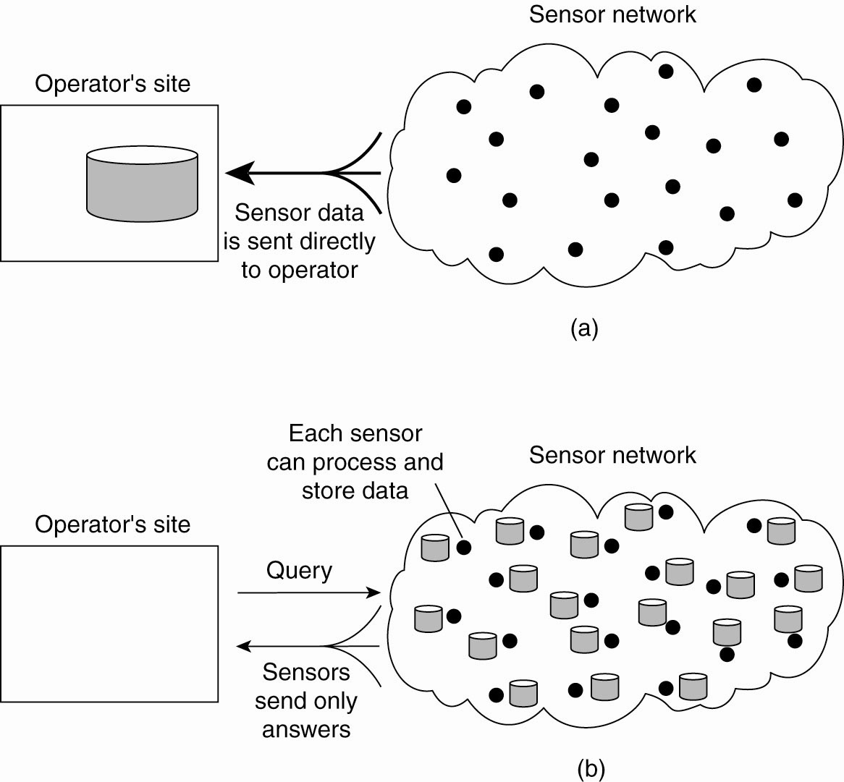
Distributed Info. Systems… Sensor Networks
Figure 1-13: Organizing a sensor network database, while storing and processing data (a) only at the operator’s site or …

Slide 38
Distributed Info. Systems… Sensor Networks
Figure 1-13: Organizing a sensor network database, while storing and processing data … or (b) only at the sensors.

Slide 39
Role of Middleware (MW)
In some early research systems: MW tried to provide the illusion that a collection of separate machines was a single computer.
  E.g. NOW project: GLUNIX middleware
Today:
  clustering software allows independent computers to work together closely
  MW also supports seamless access to remote services, doesn’t try to look like a general-purpose OS.

Slide 40
Role of MW…
Historical Perspective - NOWs
Networks of Workstations.
Designed to harvest idle workstation cycles to support compute-intensive applications.
Advocates contended that if done properly, you could get the power of an MPP at minimal additional cost.
Supported general-purpose processing and parallel applications

Slide 41
Middleware Examples
CORBA (Common Object Request Broker Architecture)
Open Network Computing Remote Procedure Call (ONC RPC)
DCOM (Distributed Component Object Management) – being replaced by .NET
Sun’s ONC RPC (Remote Procedure Call)
RMI (Remote Method Invocation)
SOAP (Simple Object Access Protocol)

Slide 42
Middleware Examples…
All of the previous examples support communication across a network:
They provide protocols that allow a program running on one kind of computer, using one kind of operating system, to call a program running on another computer with a different operating system
  The communicating programs must be running the same middleware though.

Slide 43
Middleware Examples…CORBA
“CORBA is the acronym for Common Object Request Broker Architecture, OMG's open, vendor-independent architecture and infrastructure that computer applications use to work together over networks.
Using the standard protocol IIOP, a CORBA-based program from any vendor, on almost any computer, operating system, programming language, and network, can interoperate with a CORBA-based program from the same or another vendor, on almost any other computer, operating system, programming language, and network.”
http://www.omg.org/gettingstarted/corbafaq.htm

Slide 44
Middleware Examples…ONC RPC
“ONC RPC, short for Open Network Computing Remote Procedure Call, is a widely deployed remote procedure call system. ONC was originally developed by Sun Microsystems as part of their Network File System project, and is sometimes referred to as Sun ONC or Sun RPC.”
http://en.wikipedia.org/wiki/Open_Network_Computing_Remote_Procedure_Call

Slide 45
Middleware Examples… Simple Object Access Protocol
SOAP is a lightweight protocol for exchange of information in a decentralized, distributed environment. It is an XML based protocol that consists of three parts: an envelope that defines a framework for describing what is in a message and how to process it, a set of encoding rules for expressing instances of application-defined datatypes, and a convention for representing remote procedure calls and responses.
SOAP can potentially be used in combination with a variety of other protocols; however, the only bindings defined in this document describe how to use SOAP in combination with HTTP and HTTP Extension Framework.
http://www.w3.org/TR/2000/NOTE-SOAP-20000508/

Slide 46
Distributed System Goals
Resource Availability
Distribution Transparency
Openness
Scalability

Slide 47
Goal 1: Resource Availability
Support user access to remote resources (printers, data files, web pages, CPU cycles) and the fair sharing of the resources
Economics of sharing expensive resources
Performance enhancement – due to multiple processors; also due to ease of collaboration and info exchange – access to remote services
  Groupware: tools to support collaboration
Resource sharing introduces security problems.

Slide 48
Goal 2: Distribution Transparency
A distributed system that appears to its users & applications to be a single computer system is said to be transparent.
  Users & apps should be able to access remote resources in the same way they access local resources.
Software hides some of the details of the distribution of system resources.
  Makes the system more user friendly.
Transparency has several dimensions.

Slide 49
Types of Transparency
Transparency | Description
Access | Hide differences in data representation & resource access (enables interoperability)
Location | Hide location of resource (can use resource without knowing its location)
Migration | Hide possibility that a system may change location of resource (no effect on access)
Replication | Hide the possibility that multiple copies of the resource exist (for reliability and/or availability)
Concurrency | Hide the possibility that the resource may be shared concurrently
Failure | Hide failure and recovery of the resource. How does one differentiate between slow and failed
Relocation | Hide that resource may be moved during use
Figure 1-2: Different forms of transparency in a distributed system (ISO, 1995)

Slide 50
Goal 2: Degrees of Transparency…
Trade-off: transparency versus other factors
  Reduced performance: multiple attempts to contact a remote server can slow down the system – should you report failure and let user cancel request?
  Convenience: direct the print request to my local printer, not one on the next floor
Too much emphasis on transparency may prevent the user from understanding system behavior.
Notes:
Relate to extensible OS arguments.

Slide 51
Goal 3: Openness
An open distributed system “…offers services according to standard rules that describe the syntax and semantics of those services.” In other words, the interfaces to the system are clearly specified and freely available.
  Compare to network protocols
  Not proprietary
Interface Definition/Description Languages (IDL): used to describe the interfaces between software components, usually in a distributed system
  Definitions are language & machine independent
  Support communication between systems using different OS/programming languages; e.g. a C++ program running on Windows communicates with a Java program running on UNIX
  Communication is usually RPC-based.

Slide 52
Goal 3: Openness…
Examples of IDLs
IDL: Interface Description Language
  The original
WSDL: Web Services Description Language
  Provides machine-readable descriptions of the services
OMG IDL: used for RPC in CORBA
  OMG – Object Management Group
…

Slide 53
Goal 3: Openness…
Open Systems Support
Interoperability: the ability of two different systems or applications to work together
  A process that needs a service should be able to talk to any process that provides the service.
  Multiple implementations of the same service may be provided, as long as the interface is maintained.
Portability: an application designed to run on one distributed system can run on another system which implements the same interface.
Extensibility: Easy to add new components, features.

Slide 54
Goal 4: Scalability
Dimensions that may scale:
  With respect to size
  With respect to geographical distribution
  With respect to the number of administrative organizations spanned.
A scalable system still performs well as it scales up along any of the three dimensions.

Slide 55
Goal 4: Scalability…
Size Scalability
Scalability is negatively affected when the system is based on:
  A Centralized server: one for all users
  Centralized data: a single data base for all users
  Centralized algorithms: one site collects all information, processes it, distributes the results to all sites.
    Complete knowledge: good
    Time and network traffic: bad

Slide 56
Goal 4: Scalability… Decentralized Algorithms
No machine has complete information about the system state
Machines make decisions based only on local information
Failure of a single machine doesn’t ruin the algorithm
There is no assumption that a global clock exists.

Slide 57
Goal 4: Scalability… Geographic Scalability
Early distributed systems ran on LANs, relied on synchronous communication.
  May be too slow for wide-area networks
  Wide-area communication is unreliable, point-to-point;
  Unpredictable time delays may even affect correctness
LAN communication is based on broadcast.
  Consider how this affects an attempt to locate a particular kind of service
Centralized components + wide-area communication: waste of network bandwidth

Slide 58
Goal 4: Scalability… Scalability - Administrative
Different domains may have different policies about resource usage, management, security, etc.
Trust often stops at administrative boundaries
  Requires protection from malicious attacks

Slide 59
Goal 4: Scalability… Scaling Techniques
Scalability affects performance more than anything else.
Three techniques to improve scalability:
  Hiding communication latencies
  Distribution
  Replication

Slide 60
Goal 4: Scalability… 1)Hiding Communication Delays
Structure applications to use asynchronous communication (no blocking for replies)
  While waiting for one answer, do something else; e.g. create one thread to wait for the reply and let other threads continue to process or schedule another task.
Download part of the computation to the requesting platform to speed up processing
  Filling in forms to access a DB: send a separate message for each field, or download form/code and submit finished version.
  i.e. shorten the wait times

Slide 61
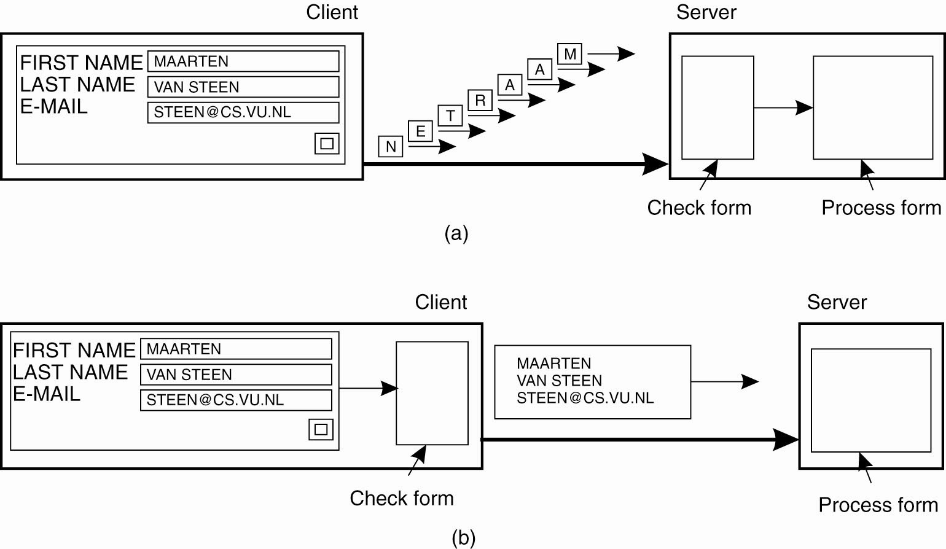
Goal 4: Scalability… Scaling Techniques
Figure 1-4: The difference between letting (a) a server or (b) a client check forms as they are being filled.

Slide 62
Goal 4: Scalability… 2)Distribution
Instead of one centralized service, divide into parts and distribute geographically.
Each part handles one aspect of the job
  Example: DNS namespace is organized as a tree of domains; each domain is divided into zones; names in each zone are handled by a different name server
  WWW consists of many (millions?) of servers

Slide 63
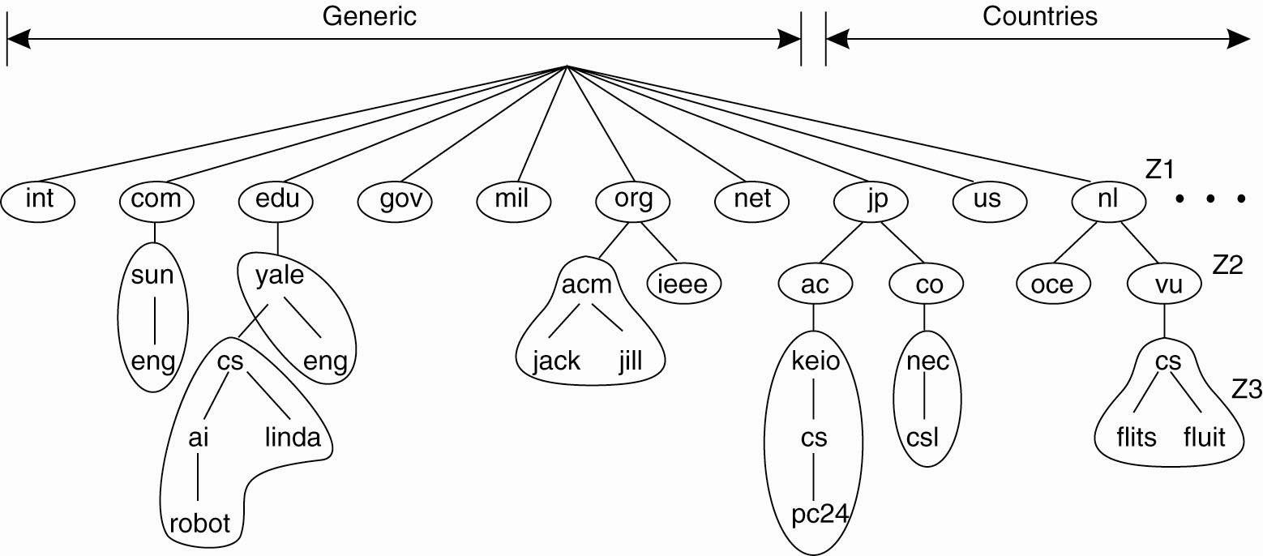
Goal 4: Scalability… DNS
Figure 1-5. An example of dividing the DNS
name space into zones.

Slide 64
Goal 4: Scalability… 3)Replication
Replication: multiple identical copies of something
  Replicated objects may also be distributed, but aren’t necessarily.
Replication
  Increases availability
  Improves performance through load balancing
  May avoid latency by improving proximity of resource

Slide 65
Goal 4: Scalability… Caching
Caching is a form of replication
  Normally creates a (temporary) replica of something closer to the user.
Replication is often more permanent
User (client system) decides to cache, server system decides to replicate.
Both lead to consistency problems.

Slide 66
Issues/Pitfalls of Distribution
Requirement for advanced software to realize the potential benefits.
Security and privacy concerns regarding network communication
Replication of data and services provides fault tolerance and availability, but at a cost.
Network reliability, security, heterogeneity, topology.
Latency and bandwidth
Administrative domains

Slide 67
Summary (1)
Goals for Distributed Systems
Resource availability
  For sharing and enhanced performance
Distribution transparency
  For easier use
Openness
  To support interoperability, portability, extensibility
Scalability
  With respect to size (number of users), geographic distribution, administrative domains.

Slide 68
Summary (2)
Types of Systems:
Distributed Computing Systems – our main emphasis.
Distributed Information Systems – we will talk about some aspects of them.
Distributed Pervasive Systems – not so much.
Notes:
Students may not know exactly what is meant by globalization or may have an incomplete understanding of the term. You might ask students what they think it means. Potential answers could include: reduction of economic and cultural advantages of developed countries, increased number of companies with operations in multiple countries worldwide, and increased reliance on imports and exports of goods (and jobs). Globalization will be discussed in later slides as well.

Slide 69
Next Week……
Internet Protocols
Lab Exercise

